Slide 1
Image captioning using DL
- Amit Kumar

Slide 2
Contents
Basics of CNN Basics of LSTM Image Captioning
- What is CNN - LSTM - Image captioning using CNN
- CNN Layer - LSTM Cell & LSTM
- Activation function(RELU) - Code demo
- Pooling
- Fully connected layer

Slide 3
What is CNN(Convolutional Neural Network)
Convolution in English means “a coil or twist”
In mathematics, convolution is operation on two functions (f and g) that produces a third function expressing how the shape of one is modified by the other
In ML/AI terms, CNN is a deep learning algorithm that specializes in extracting features of input images thus helping in identifying or classifying images

Slide 4
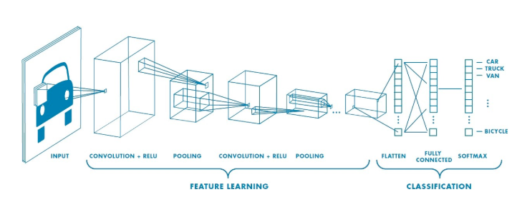
What is CNN(Convolutional Neural Network)

Slide 5
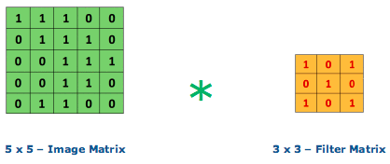
CNN Layer
Convolutional layer is the core building block of CNN
Convolutional layer does a dot product of matrix between the input image and the filter/kernel
The filter/Kernel have the weight values and are updated after every iteration through back propagation
In this figure , we can see that a 5 X 5 input image matrix is being multiplied with 3 X 3 filter matrix

Slide 6
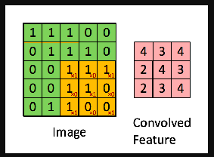
CNN Layer
In this figure the area highlighted in yellow is known as the receptive field, it is area in input image where the filter is currently focused at
The size of the receptive field is equal to size of the filter
The values in the current focus of input image will be multiplied with filter and summed up. This new value would be the output in the activation/feature map or convolved feature(in pink)
The Filter moves through the image by taking a stride(step) of some predefined value(generally 1 or 2).The output out of multiplication of each receptive field and filter will update one value in feature map.
Once the whole image is covered we will get a 3 x 3 feature map matrix as shown in the figure

Slide 7
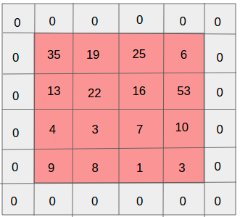
CNN Layer
The output of Convolutional layer is feature map matrix
The filter size and stride used during convolution are hyper parameter
For a 5 X 5 X 3 input image, Height(h) = 5,Width(w)=5,Dimensions(d) /channels = 3 . The channel comprises of the RGB values.
Zero Padding - In the example provided in this section, a 3 X 3 filter matrix convolves upon a 5 X 5 image matrix to produce a 3 X 3 feature map. There could be instances where the filter may not fit the input image, here we can zero pad the input image so that filter can convolve over input image and produce feature map of required dimensions.

Slide 8
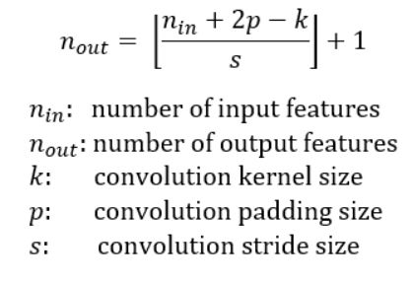
CNN Layer
number of output features in each dimension can be calculated using the following formula

Slide 9
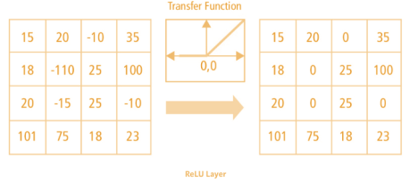
Activation Layer
Activation function is used in convolutional layer to handle the non-linearity
RELU(Rectified Linear Unit) is used to convert all negative values in zeros in the feature map

Slide 10
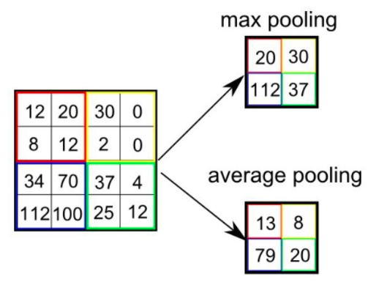
Pooling
Pooling layer is used to reduce the spatial size of the feature map or the convolved feature
There are two types of pooling:Max Pooling and Average Pooling
Max Pooling - The maximum value from the receptive field is returned
Average Pooling - Average of all the values in the receptive field is returned

Slide 11
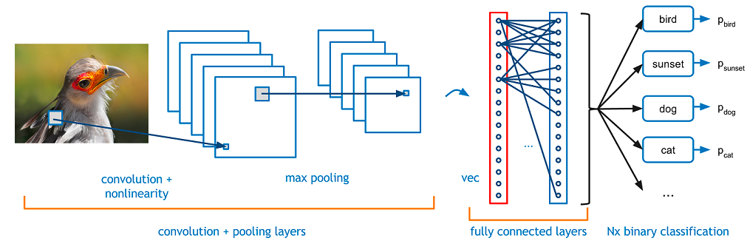
Fully connected layer
In Fully connected layer all the outputs from convolution layer+relu+pooling are stacked together by flattening the output(image) into vector
After stacking the process or functionality followed is similar to multi level perceptron where flattened output is fed to a feed-forward neural network and backpropagation applied to every iteration of training

Slide 12
What is LSTM(Long Short Term Memory)
LSTM is a recurrent neural network(RNN) used in areas where long term memory is required for processing
The property of long term memory retentivity distinguishes LSTM from basic RNN
LSTM has varied applications - image captioning, time series prediction, handwriting recognition , etc..
LSTM is able to perform the complex function of remembering/forgetting words using LSTM cell
An important component of LSTM cell is the cell state which enables the cell to retain context or forget them

Slide 13
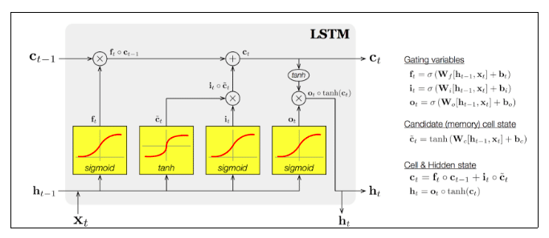
LSTM cell
An LSTM cell is a memory unit comprising of an input gate, an output gate and a forget gate. The cell remembers values over arbitrary time intervals and the three gates regulate the flow of information into and out of the cell.

Slide 14
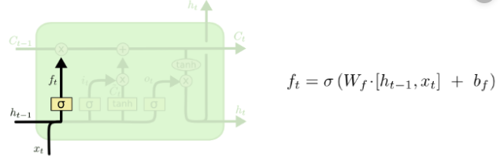
Functioning of an LSTM cell – Forget gate
A forget gate decides what content to retain and what to forget. To achieve this, it follows the below steps:
It takes h_t-1 which is the hidden state from the previous cell or the output of the previous cell and x_t is the input at that particular time step
The given inputs are multiplied by the weight matrices and a bias is added
After this, the sigmoid function is applied to the calculated vales which transforms /converts the value in the range 0 to 1
If the output is 0, forget gate wants cell state to forget the information whereas if its 1 ,information should be retained

Slide 15
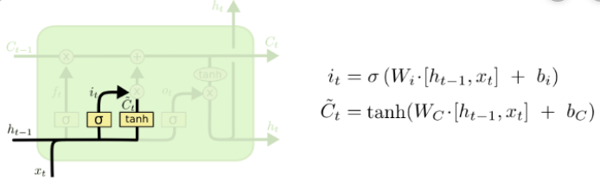
Functioning of an LSTM cell – Input gate
The input gate is responsible for addition of information to cell state. To achieve this, it follows the below steps:
Sigmoid gate is involved to regulate the values that needs to be added to the cell state
A vector is created containing all possible values that can be added (h_t-1 and x_t) to the cell state. This is done using the tanh function, which outputs values from -1 to +1
The output from the regulatory filter (the sigmoid gate) is multiplied with the created vector (the tanh function) which is then added to the cell state via addition operation

Slide 16
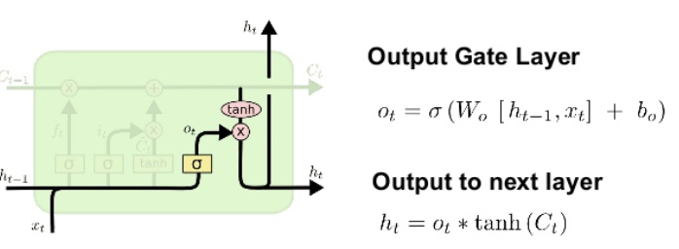
Functioning of an LSTM cell – Output gate
Output gate performs the selection of useful information from the current cell state and outputs it. To achieve this, it follows the below steps:
Creation of a vector after applying tanh function to the cell state, thereby scaling the values to the range -1 to +1
Sigmoid function is used to filter the values from the inputs h_t-1 and x_t
Multiplying the value of this regulatory filter(Sigmoid function) to the vector created in the first step and sending it out as a output

Slide 17
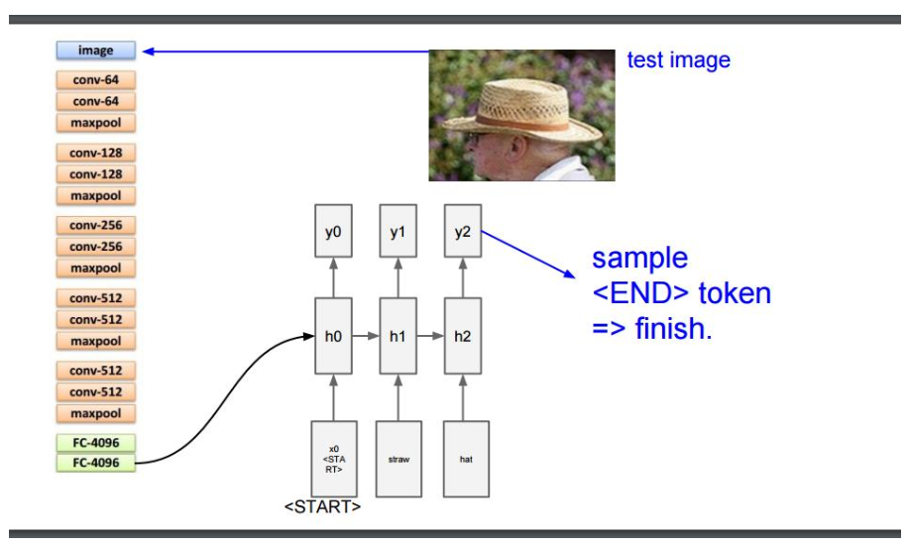
Image Captioning

Slide 18
Image Captioning
In Image Captioning, automatic descriptions are generated for images.
CNN is used to extract the features from an image which is then along with the captions is fed into an LSTM.
To extract the features, we use a model trained – VGG16
Flickr8k dataset containing 6000 training images, 1000 validation images and 1000 testing images has been used here. Each image has 5 captions describing it.

Slide 19
Image Captioning
Steps followed:
Photo and Caption Dataset
Prepare Photo Data
Prepare Text Data
Develop Deep Learning Model
Train With Progressive Loading
Evaluate Model
Generate New Captions

Slide 20
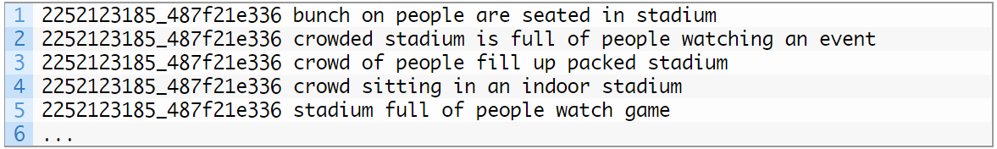
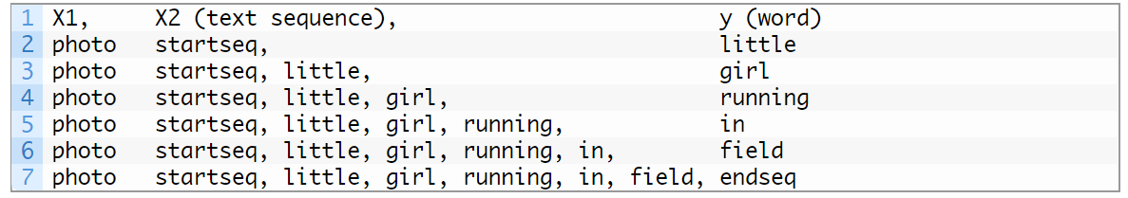
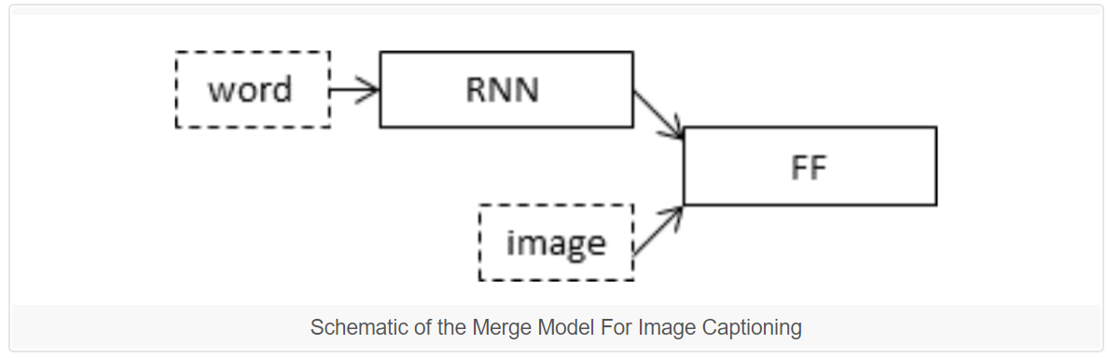
Image Captioning
Some references for the code:

Slide 21
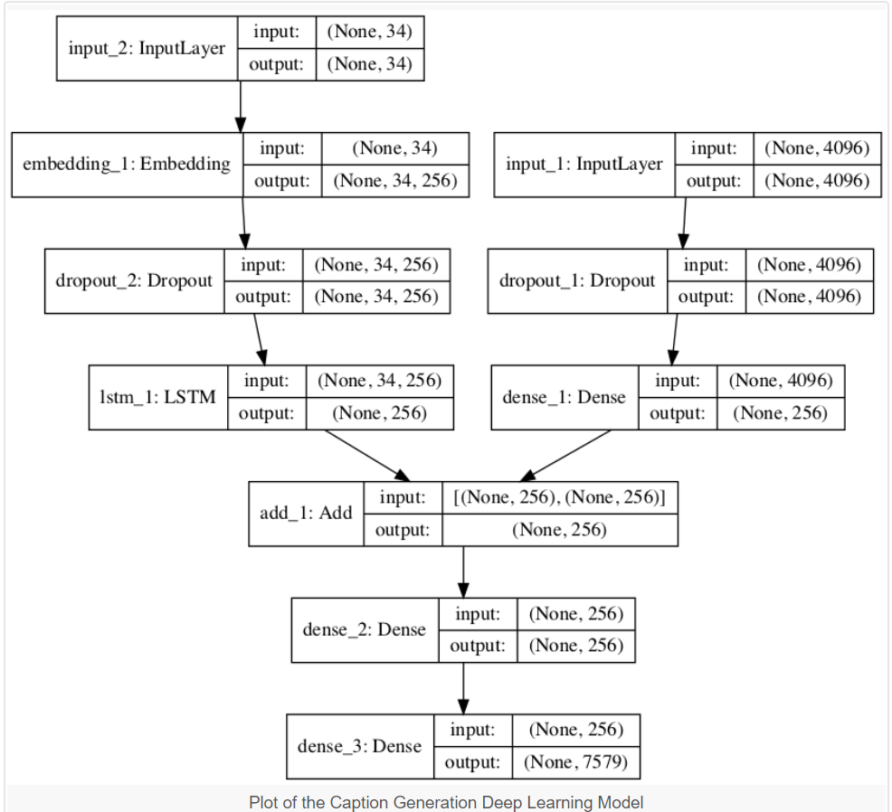
Image Captioning
Some references for the code:

Slide 22
Thank You

